Slide 1
FRB Update #28
William Huang
(07/28/2021)

Slide 2
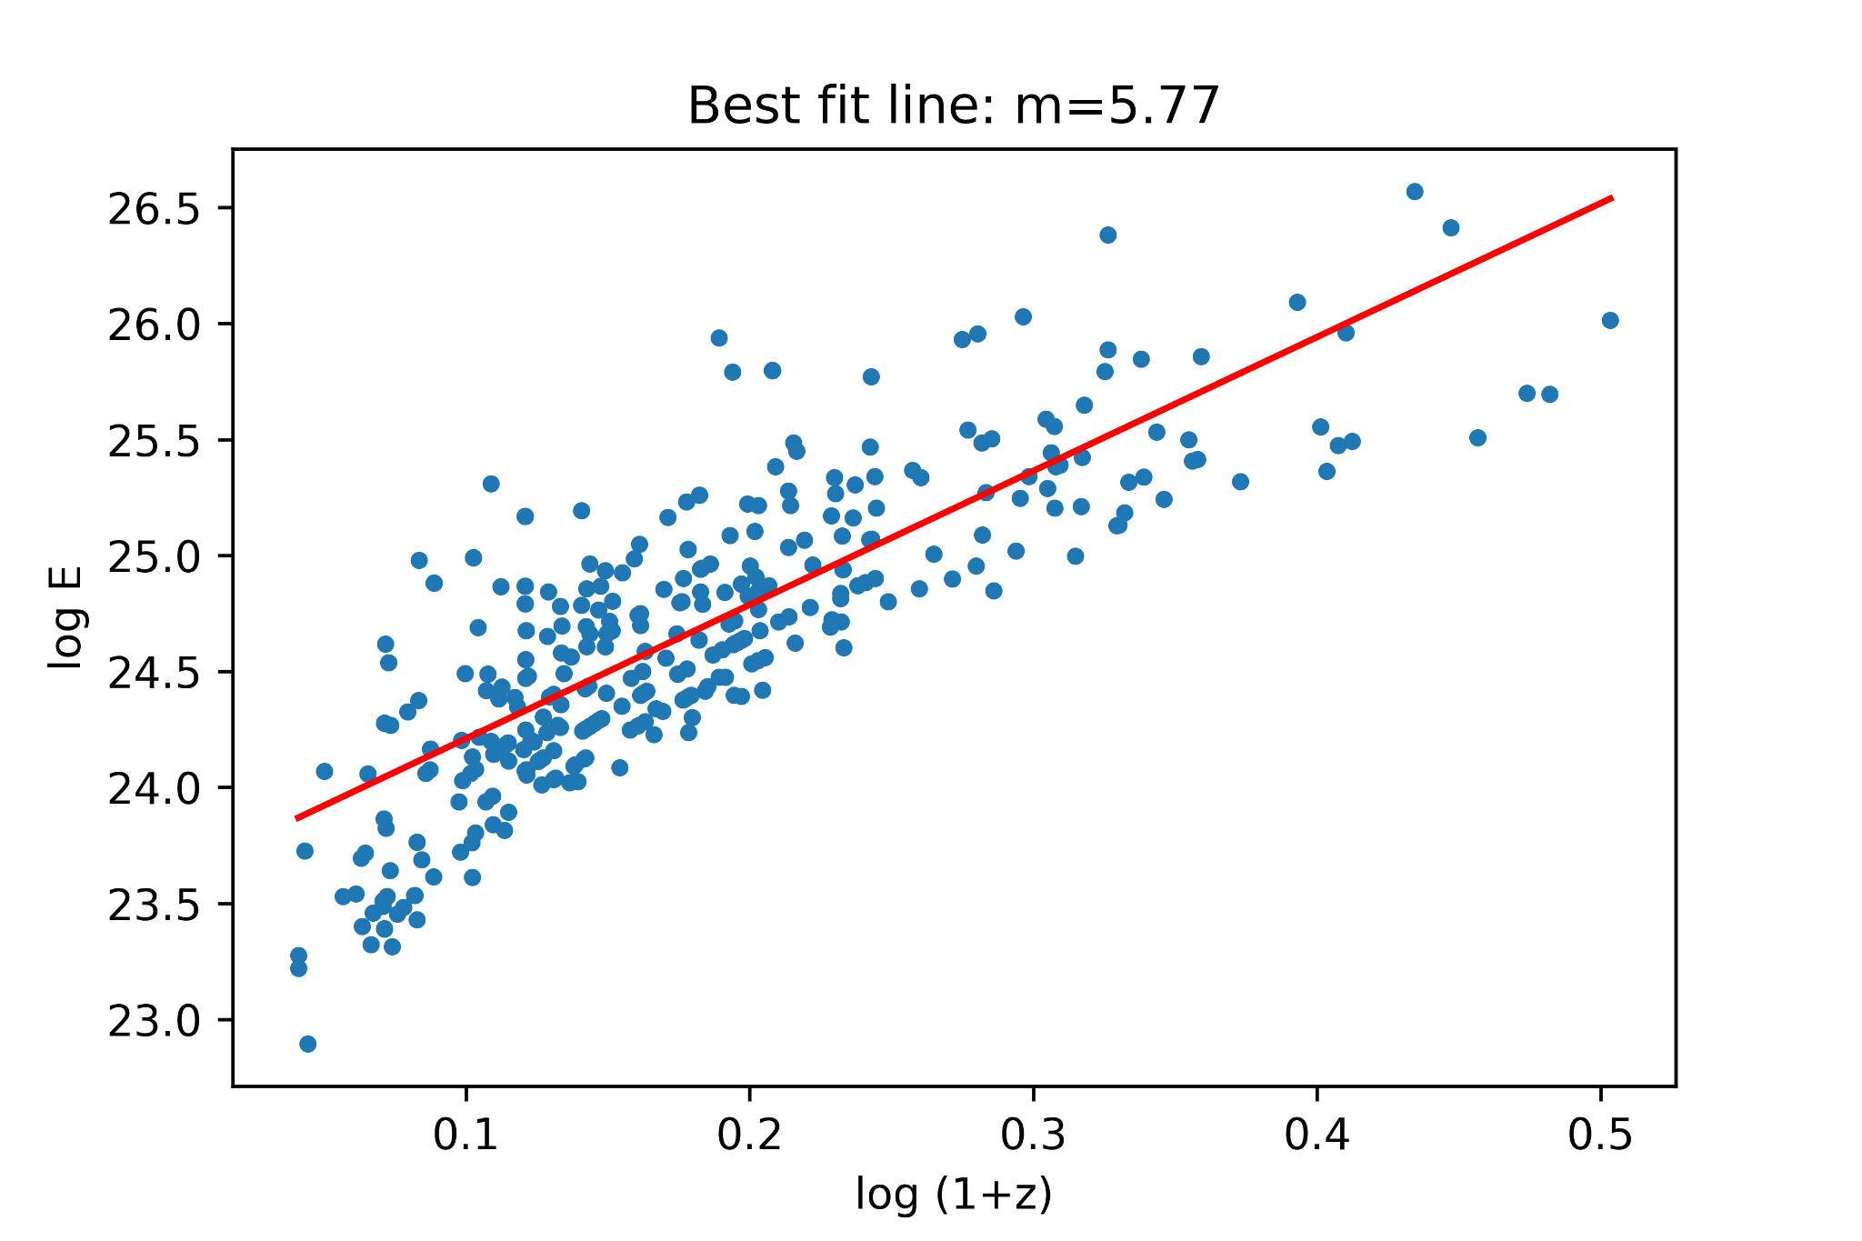
log(E) vs. log(1+z) fit
A linear fit of log E versus log(1+z) for FRBs above 2 Jy ms yields a power of 5.77, which is high, but not quite as high as the results of kendall tau.

Slide 3
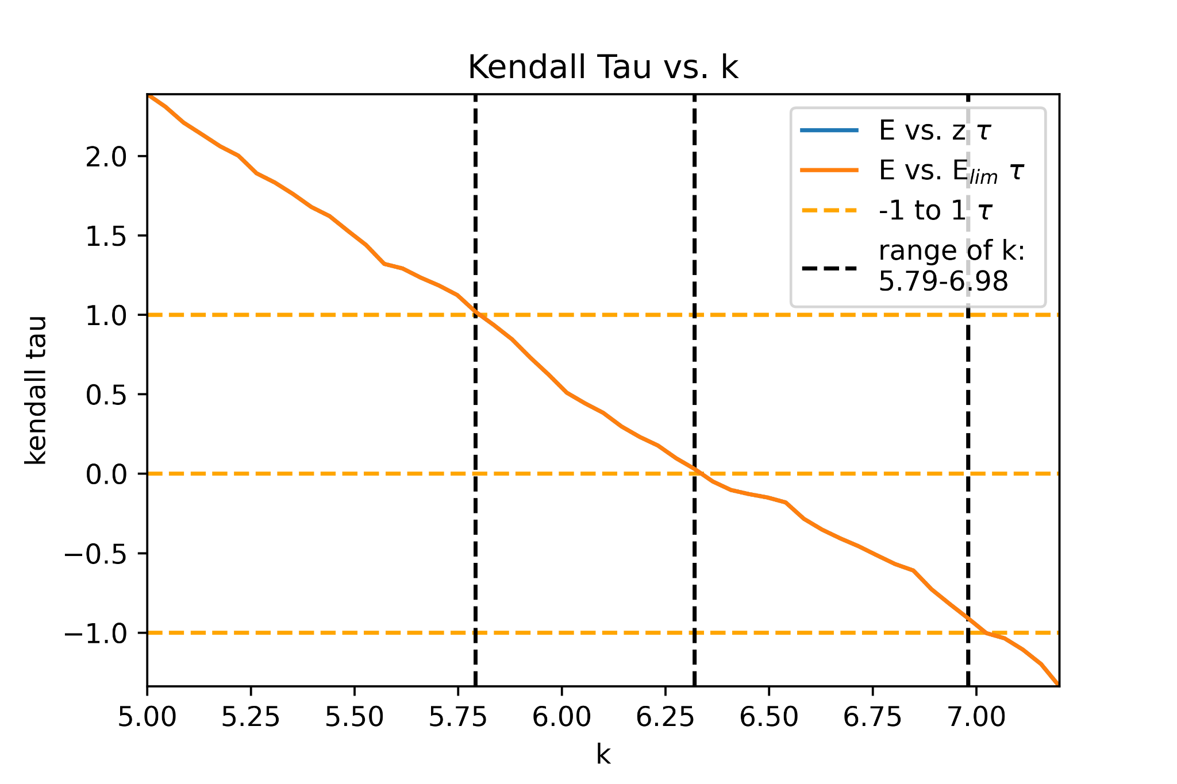
New kendall tau results
Previously in kendall tau, I used E_{i} = 1/2 and V_{i} = 1/12, but upon looking at Efron and Petrosian (1992), it seems that the expectation value and variance should actually be:
E_{i} = (1+1/N_{i})/2 V_{i} = (1-1/N_{i}²)/12
where N_{i} is the number of events in the associated set. The graph on the right reflects this change; the change puts k between 5.79 and 6.98, which is still above 5.77.

